Slide 1
Solar Power Company Model Report
Stephanie Jense
Springboard capstone 2
Final presentation

Slide 2
Outline
Business Problem
Success Indicators
Data
Data Analysis
Model Results

Slide 3
The Business problem
SPC has been having issues with back up power when output is low so they have set out to have a model built to predict output so the company can be better prepared for power shortages.
Goals: Build a model to predict power output based on weather and solar data provided by the local weather station.

Slide 4
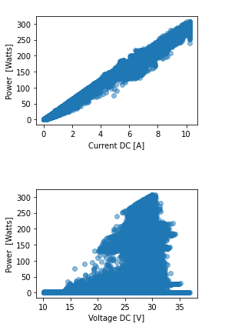
Data
Yearly data for both the solar cell farm and weather station data is provided
2014, 2015, 2016
Current & Voltage will be discounted from the model as we know current*voltage = Power

Slide 5
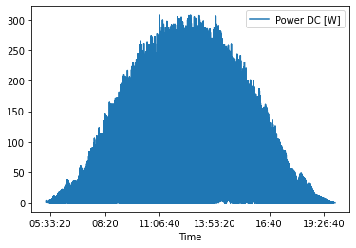
Data Analysis

Slide 8
Model Results
The model performed extremely well
If computational cost is an issue, a linear regression model can be used in place of the more computationally intensive random forest best model.
On average, we were only off by 2.61 Watts of Power for every minute (row) of data.
MAE = 2.61
MSE = 19.68
R2 = 0.996

Slide 9
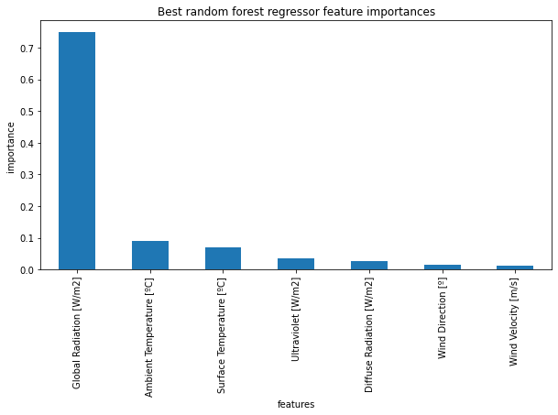
Feature Importance

Slide 10
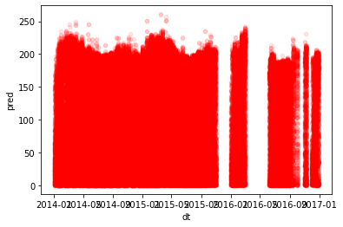
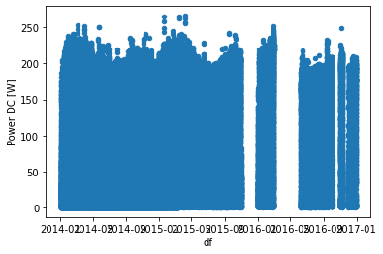
Predictions

